Slide 1
SECURITY ANALYSIS & PORTFOLIO MANAGEMENT
UNIT- 4
BY
ARTI (MBA)
HINDU INSTITUTE OF MANAGEMENT & TECHNOLOGY, ROHTAK

Slide 2
Portfolio Revision
Portfolio Meaning:
A combination of various investment products like bonds, shares, securities, mutual funds and so on is called a portfolio.
In the current scenario, individuals hire well trained and experienced portfolio managers who as per the client’s risk taking capability combine various investment products and create a customized portfolio for guaranteed returns in the long run.
.

Slide 3
It is essential for every individual to save some part of his/her income and put into something which would benefit him in the future. A combination of various financial products where an individual invests his money is called a portfolio

Slide 4
Portfolio Revision
The art of changing the mix of securities in a portfolio is called as portfolio revision.
The process of addition of more assets in an existing portfolio or changing the ratio of funds invested is called as portfolio revision. The sale and purchase of assets in an existing portfolio over a certain period of time to maximize returns and minimize risk is called as Portfolio revision.

Slide 5
Need for Portfolio Revision
An individual at certain point of time might feel the need to invest more. The need for portfolio revision arises when an individual has some additional money to invest.
Change in investment goal also gives rise to revision in portfolio. Depending on the cash flow, an individual can modify his financial goal, eventually giving rise to changes in the portfolio i.e. portfolio revision.
Financial market is subject to risks and uncertainty. An individual might sell off some of his assets owing to fluctuations in the financial market.

Slide 6
Portfolio Revision Strategies
There are two types of Portfolio Revision Strategies.
Active Revision Strategy
Active Revision Strategy involves frequence changes in an existing portfolio over a certain period of time for maximum returns and minimum risks.
Active Revision Strategy helps a portfolio manager to sell and purchase securities on a regular basis for portfolio revision.

Slide 7
Passive Revision Strategy
Passive Revision Strategy: Passive Revision Strategy involves rare changes in portfolio only under certain predetermined rules. These predefined rules are known as formula plans

Slide 8
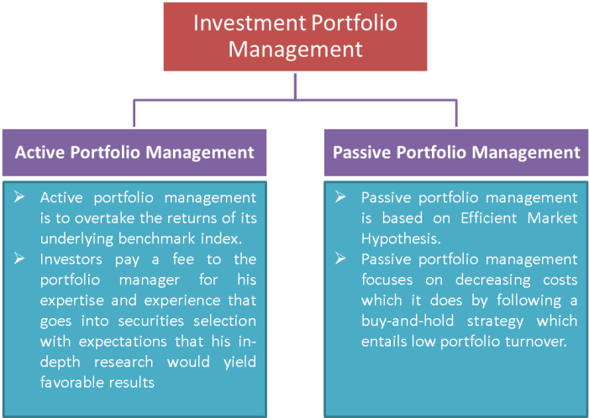

Slide 9
Formula Plans
Formula plans help an investor to make the best possible use of fluctuations in the financial market. One can purchase shares when the prices are less and sell off when market prices are higher.
With the help of Formula plans an investor can divide his funds into aggressive and defensive portfolio and easily transfer funds from one portfolio to other.

Slide 10
Aggressive Portfolio: Aggressive Portfolio consists of funds that appreciate quickly and guarantee maximum returns to the investor.
Defensive Portfolio: Defensive portfolio consists of securities that do not fluctuate much and remain constant over a period of time.
Formula plans facilitate an investor to transfer funds from aggressive to defensive portfolio and vice a versa

Slide 11
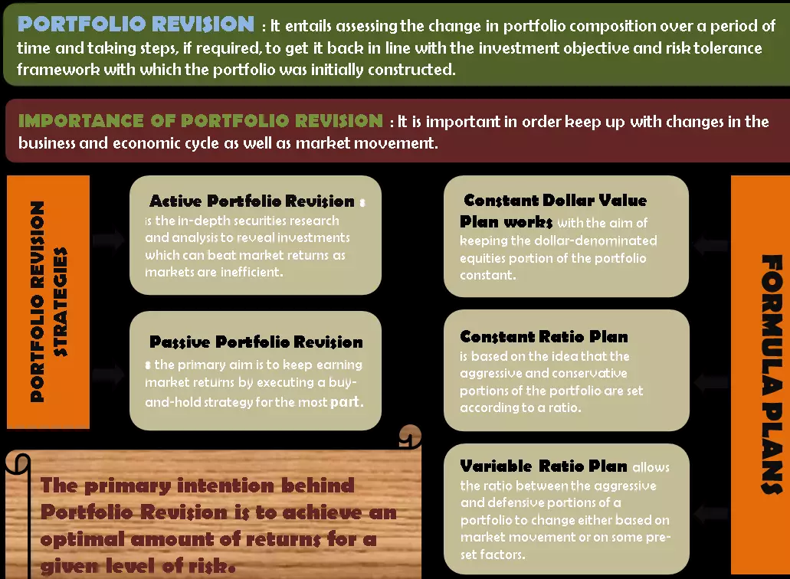

Slide 12
CONSTANT DOLLAR VALUE PLAN
The constant dollar value plan works with the aim of keeping the dollar-denominated equities portion of the portfolio constant. This implies that if the value of the equities portion rises beyond the set dollar value due to favorable market movement, some stocks from that aggressive segment of the portfolio will be sold in order to maintain the constant dollar value pre-determined for it.

Slide 13
This also works the other way around in that if the value of the aggressive segment decline because stock prices have fallen, more stocks need to be purchased in order to maintain the constant dollar value.

Slide 14
A constant ratio plan
A constant ratio plan is a strategic asset allocation strategy, which keeps the aggressive and conservative portions of a portfolio set at a fixed ratio. When the actual ratio of holdings differs from the desired ratio by a predetermined amount, transactions are made to rebalance the portfolio

Slide 15
VARIABLE RATIO PLAN
The variable ratio plan builds on where the constant ratio plans stop by providing higher flexibility than the latter does. The plan allows the ratio between the aggressive and defensive portions of a portfolio to change either based on market movement or on some pre-set factors.

Slide 16
For instance, a variable ratio plan can allow for a higher ratio of the aggressive portion vis-à-vis the conservative portion when equities are doing well in order to benefit from the bull-run. The plan can also allow for a higher ratio in favor of the defensive portion as an investor grows old and his life cycle demands a more conservative approach to investments.

Slide 17
Passive Revision Strategy
Passive Revision Strategy: Passive Revision Strategy involves rare changes in portfolio only under certain predetermined rules. These predefined rules are known as formula plans.

Slide 18


